Slide 1




Ming Wu (Andrew) 2133861w
Laser Mate!
Project Supervisor Meeting 13
12 February 2021

Slide 2
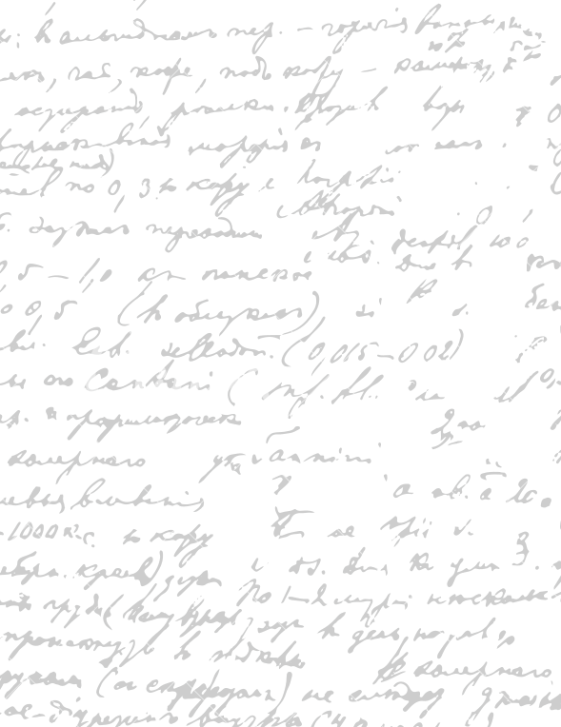



Start Recording

Slide 3
Main Topics
Evaluate dissertation
Rank what to do first

Slide 4



1. Rank Project Parts
Writing Dissertation - xx
Software Coding -xx
Evaluation -xx

Slide 5
Q1. What is an acceptable number of participants for digital prototype evaluation?
Q2. Should we post the paper prototype in the dissertation or the appendix? Could you give some opinions for the paper prototype and related software product sections? (go to that part of the dissertation)
Q3. The web demo takes up quite a lot of space, probably 1 page for 3 web diagrams. If we decrease the image size, it makes it difficult to read the web text as well. Would you make it smaller or keep it like that?
Q3. Should I discuss about the coding platform at all? E.g. why we have come up with the decisions to use React.JS, PostgreSQL and Django?
Ask Stephen to read the whole dissertation in the order he wants for refinement and evaluation
Or
Final Software Product
2. Evaluate Dissertation
Parts

Slide 6
End

